Slide 1


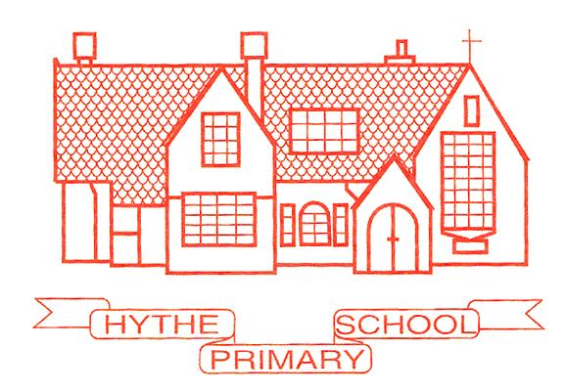
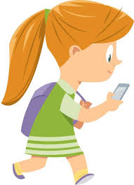

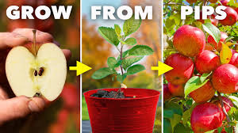
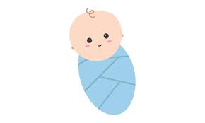

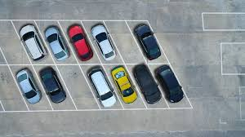

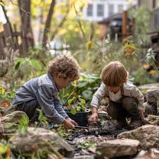
Do you have a child starting school in September 2026?
Be Inspired
Watch your child grow in our Apple Class
Our mission is to be
Free local parking
Inclusive
Nurturing
Supportive
Positive
Inquisitive
Reflective
Exciting
Developing
Wraparound Provision
Busy bee time to learn, discover and grow
Open events held on Wednesday 22 October at 9.15 and Monday 24 November at 9.15. Children welcome.

